Slide 1
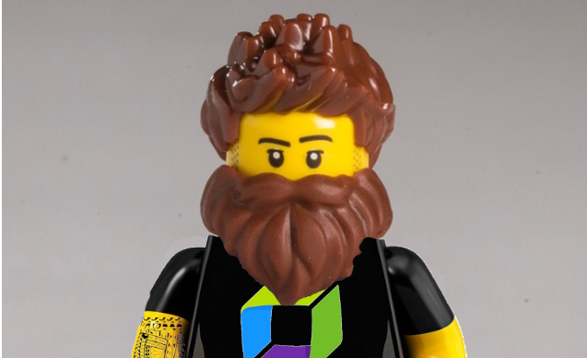
The Freedom of Kubernetes requires Chaos Engineering to shine in production
Henrik Rexed
Cloud Native Advocate

Slide 2





About the speaker
Henrik Rexed
Cloud Native advocate, Dynatrace
15 years + of Performance engineering
Organizer of The Performance Advisory Council
Owner of the YouTube Channel Is it Observable
One of the producer of Perfbytes
Henrik.rexed@dynatrace.com
@hrexed
www.linkedin.com/in/hrexed/
henrikrexed

Slide 3




If you stay with me…
Learn about K8s challenges
What is Chaos Engineering
How to validate your K8s settings with the help of Chaos Engineering
What type of metrics and events to collect

Slide 4
The dark side of kubernetes

Slide 5







Let’s recap on the Workload lifecyle
Pending
Running
Creating
Deployment.yaml

Slide 6
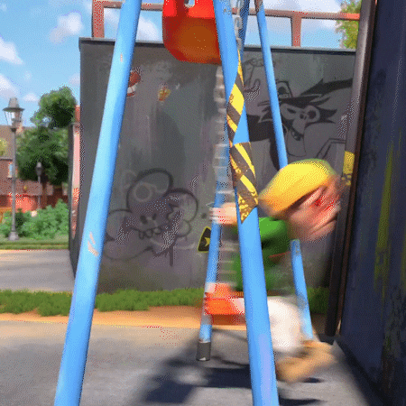



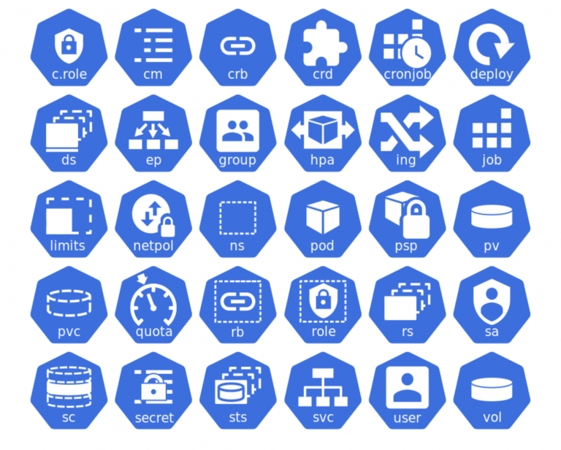
Once up on the time….K8S killed my workload
Evicted
Notes:
But Eviction make sense….how can we avoid this ?
How can we ask k8S to evicte critical workload from our clusters?

Slide 7

What are the options to avoid this?
Limit
Let’s control the workload on our node by defining :
Request/limits on our POD
Defining limits will automatically define a QoS:
Guaranteed ( request = limit)
Burstable ( request < limit)
Best effort ( no limits define)
Let’s define quotas on a Namespace
Max resource
Request
apiVersion: v1
kind: ResourceQuota
metadata:
name: mem-cpu-demo
spec:
hard:
: requests.cpu: "1"
requests.memory: 1Gi
limits.cpu: "2“
limits.memory: 2Gi
pods: “10”
Notes:
Request /Limits --- OOM Kill ( beware we need to watch

Slide 8
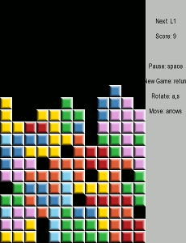
Request will help Kubernetes
Request is designed to help Kubernetes manage the resource allocation within your nodes.
Request is defined :
CPU : in millicore
Memory in bytes
If the Request is too high , we won’t utilize our resource efficiently

Slide 9

Limits define our contract
Limits will define the resource contract of our containers.
Limits is defined :
Memory in bytes
CPU in function time ( 1 will mean 100ms)
Limit | Too low | Too High
CPU | CPU Throttling | Starve other Pods or impact ressource usage
Memory | Killed by kernel | Starve other pods or impact ressource usage

Slide 10
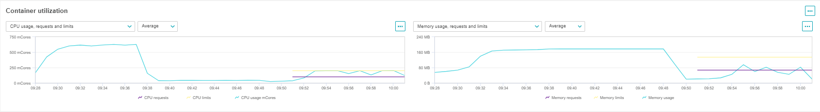
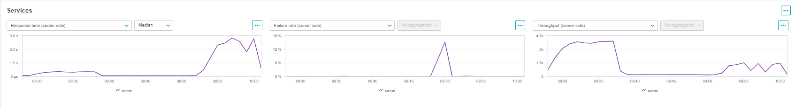
But ….
without
with
without
with

Slide 11
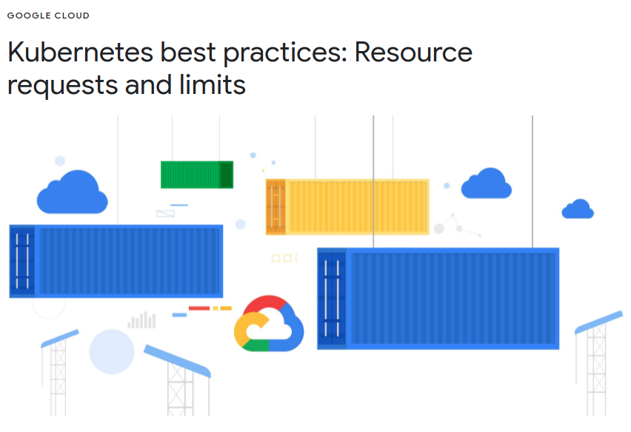

Requests and limits is a best practices
“While your Kubernetes cluster might work fine without setting resource requests and limits, you will start running into stability issues as your teams and projects grow”
(Google, Kubernetes best practices)
https://cloud.google.com/blog/products/containers-kubernetes/kubernetes-best-practices-resource-requests-and-limits

Slide 12
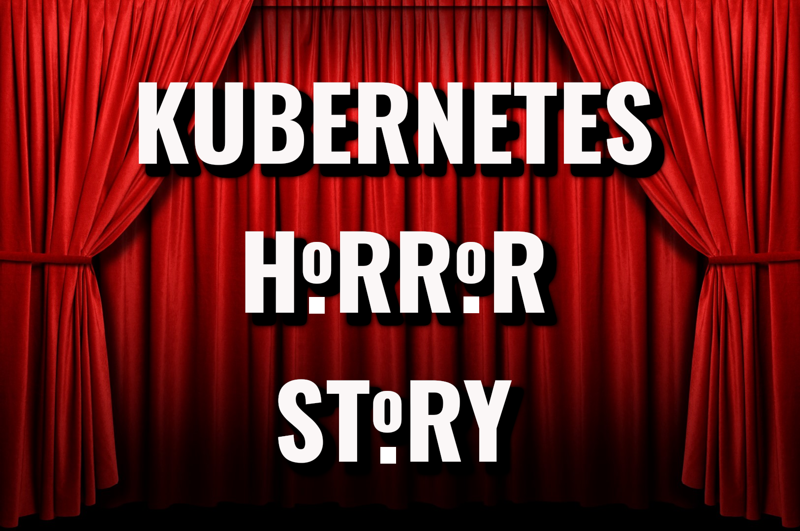

Kubernetes Horror stories
Performance issues (high latency, CPU throttling)
Airbnb, Buffer, Omio, Zalando, Civis Analytics, Target, Adevinta, Algolia
Stability issues (OOM kills)
AirBnb, Blue Matador, Zalando, Datadog, NU.nl, Yahoo, Nordstrom
List of K8s stories

Slide 13


In a not-so-distant past…
This new release has added lots of new features that requires more CPU and Memory usage. Let’s increase the requests , limits and more Replica!
Why do we have alerts on our K8s nodes?
Application Owner
Operations
Resources used
Resources used
Node A
Node B

Slide 14
Chaos engineering

Slide 15
Chaos engineering is a process to discover vulnerabilities by :
Injecting failures
errors

Slide 16
The Chaos workflow
Define hypotheis
Define what could fail
Predict how our system react
Define KPI that will help us validate our experiments
1
Define Experiment
Define the workflow of your experiment
How to rollback
How to collect the right KPI
2
Run the experiments
3

Slide 17
What hypotheis for K8s

Slide 18

Hypotheis
Kubernetes settings
Expectation
Stable and performant
Low error rate
Maintenance
Expectation
Stable
No user impacted
Eviction
Expectation
No downtime
Stable and performant

Slide 19
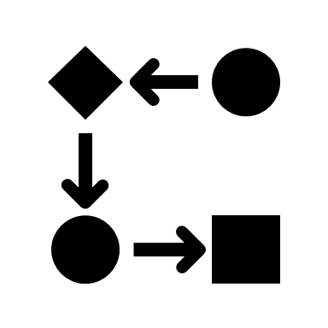


What observability pillars will help us to detect K8S issues
Logs
metrics
Logs
K8S events
Metrics
Traces
Dynatrace Kubernetes Operator

Slide 20
Important metrics and events

Slide 21


Indicators to track configuration issues
Application
Response time
Failure rate
Node
CPU/Memory Usage
Number of running pods
Node
Cluster
Pod
Pod
CPU/Memory requests
CPU/Memory limits
CPU/Memory usage
Containers
Container
CPU throttling
Memory usage
CPU usage

Slide 22
Events to track configuration issues
Node
Node Pressure
Node
Pod
Failed Scheduling
Eviction
OOM kill events
Cluster
Pod
Containers

Slide 23
What kind of experiments for K8s

Slide 24


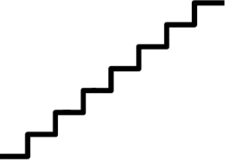





Eviction and Maintenance
Node Drain
Simulate Node pressure by
Generate CPU stress on the nodes
Generate Memory use on the nodes
Load
App Error Rate
00:00:00
00:00:30
00:01:00
00:01:30
Virtual Users Load

Slide 25
Validate our K8s settings
Run constant load
Measure response time and failure rate of your application
Load
App Error Rate
00:00:00
00:00:30
00:01:00
00:01:30
Virtual Users Load

Slide 26
What do you we need?

Slide 27

Your technical environment

Slide 28
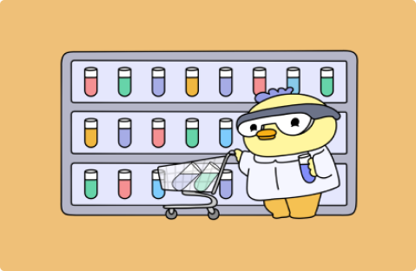
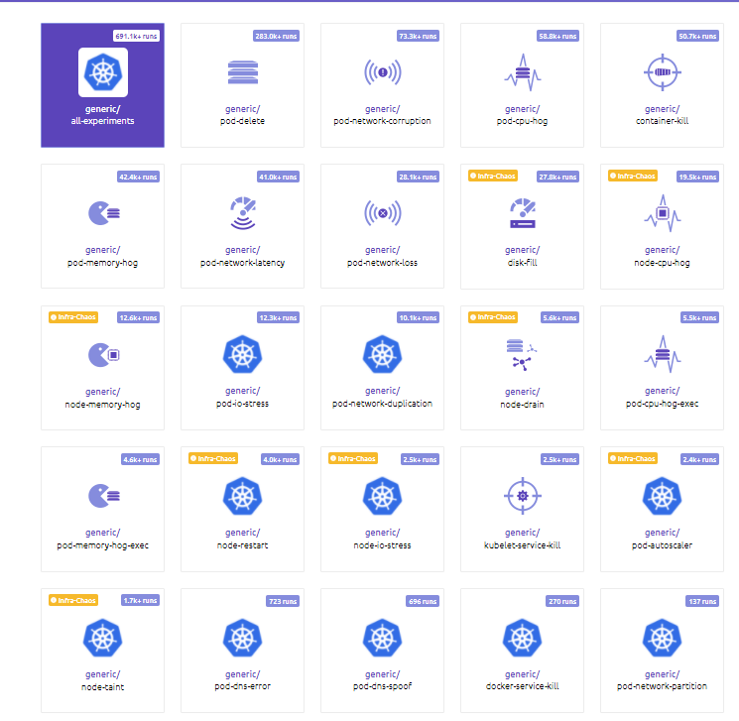

Litmus Chaos
Chaos Center
Agent
Chaos Exporter

Slide 29
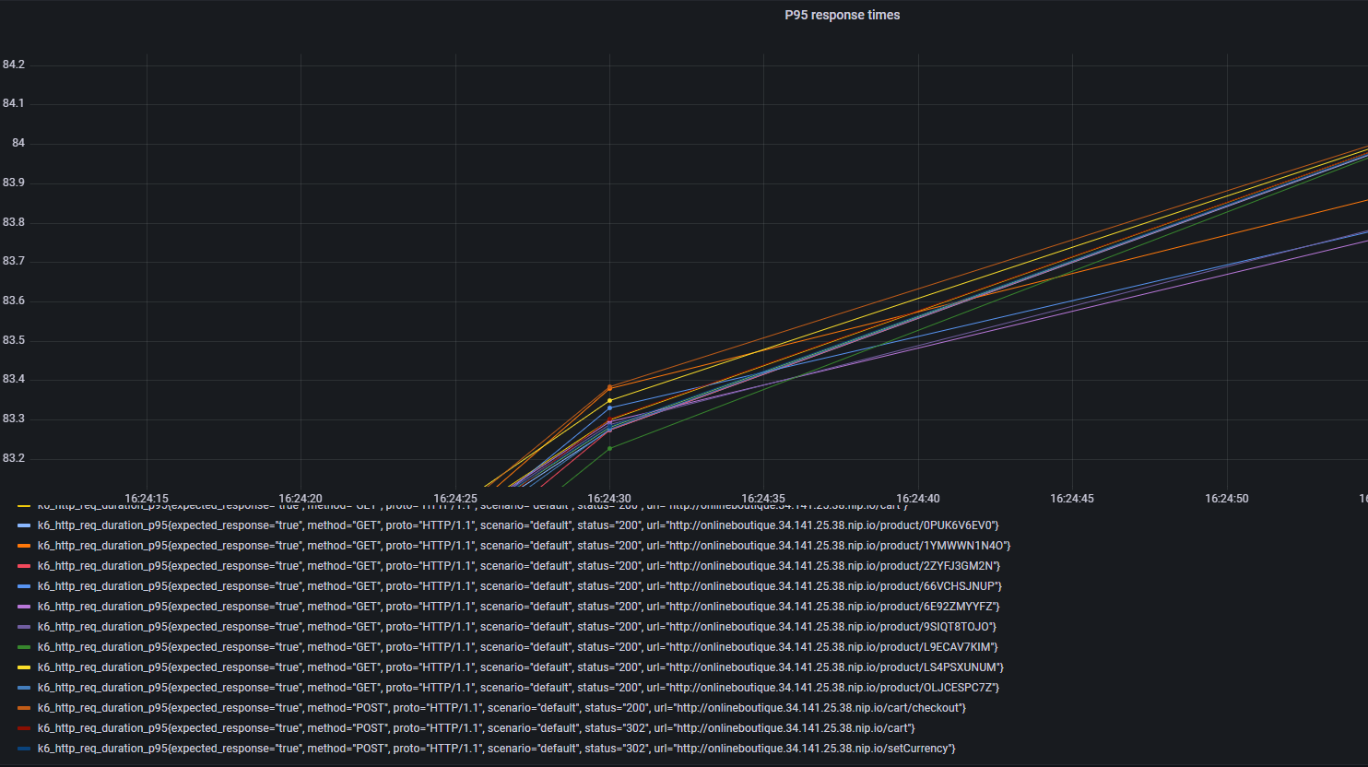
K6 – The Prometheus integration
K6

Slide 30

Dynatrace
Kube State metrics
Node exporter
Cadvisor
Litmus
K6
Dynatrace
Kubernetes monitor

Slide 31
How can we automate ?

Slide 32










Let’s bring automation
Build
Deploy
Application
Deploy
New Exporter
Deploy service
And configure Dynatrace
Test
Manual Approval
Promote to "Staging"

Slide 33
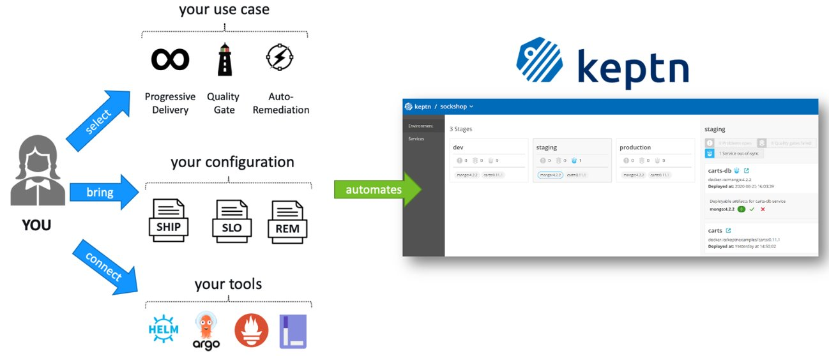
Let’s utilize Keptn to automate our Analysis

Slide 34

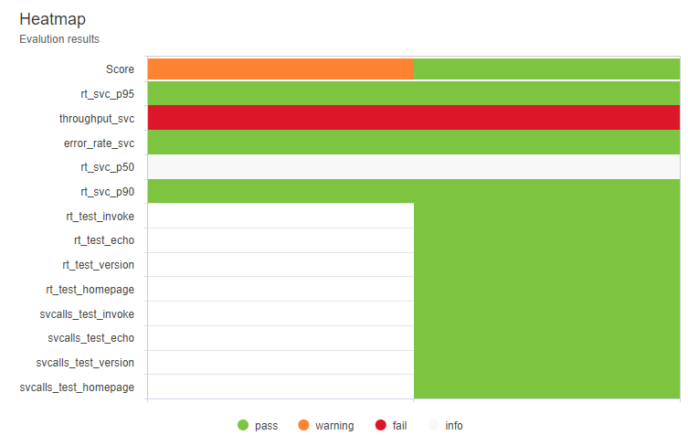

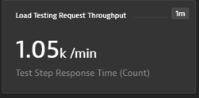
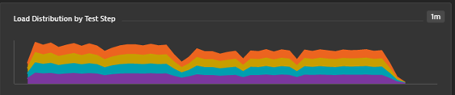
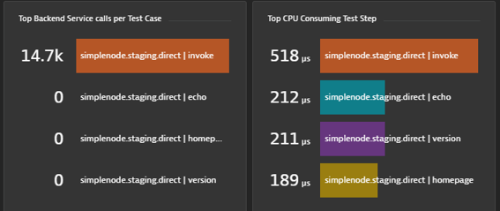
The revisited pipeline
Build
Deploy to
„Test“
Run Test
In „Test“
Manual Approval
~30-60min
Promote to „Staging“
Build
Deploy to
„Test“
Run Test In „Test“
w Tagging
Trigger
Quality Gate
~1min
Wait for
Result
Promote to „Staging“
Tagging
Result: success, Score: 85/100
SLI & SLO
PodFailure < 1%
NodePressure <= 1%
cpu(max)< 80%
...
Validate
SLOs
Pull SLIs for Testing time frame

Slide 35
Take away
SRE
Quotas
Define Qos
Define RessourceQuotas
Observability
K8S
Collect metrics, Traces and Logs
Define metrics based on logs
Build alerting rules based on events
Utilize load testing & Chaos engineering to measure the impact of K8s events on your users
Define SLI/SLO

Slide 36

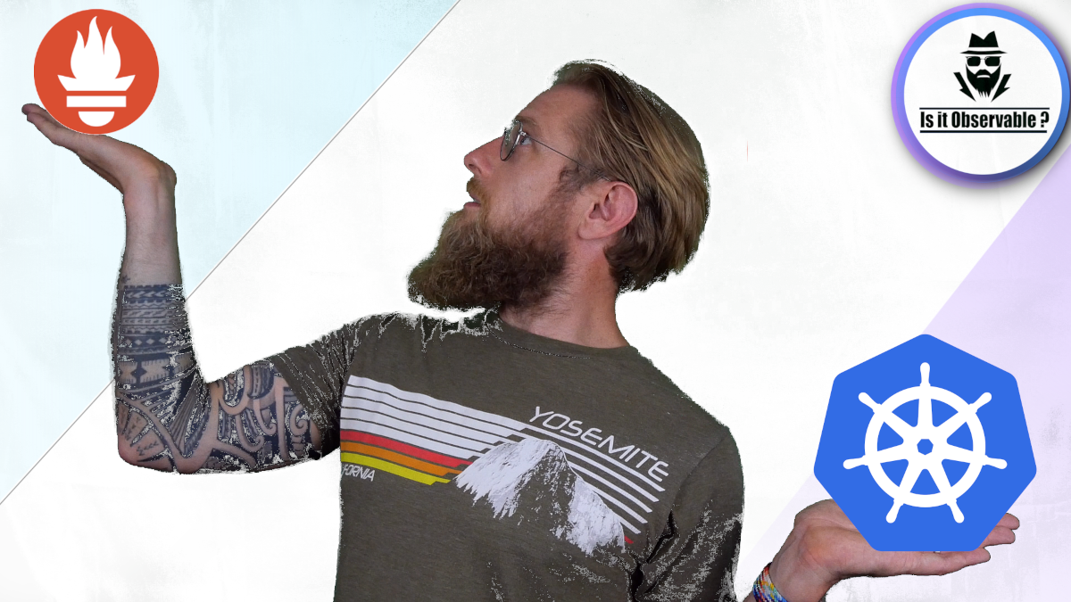






Is it observable
Looking for educational content on Observability , Checkout the YouTube Channel :
Is It Observable https://www.youtube.com/c/IsitObservable

Slide 37
Thank you

